Slide 1
Data Mining for Business Harvard CSCI E-96
Ted Kwartler
https://www.linkedin.com/in/edwardkwartler/
edwardkwartler@fas.Harvard.edu

Slide 2
Agenda
Start | End | Item
 |  | Introductions
 |  | Syllabus Review
 |  | Break
 |  | Intro to R
 |  | R Installation, environment & git
 |  | Simple R Scripting

Slide 3











Ted Kwartler
MBA
Work
Teaching
Advisory Roles

Slide 4
Logistics
Ed Discussion
Course Discussion Board
https://edstem.org/us/courses/45993/discussion/
Canvas
System of Record for Grades
https://canvas.harvard.edu/courses/131328
Zoom
Video
Lecture links in Canvas site for security
Class Material
The course repository has slides, data and scripts
https://github.com/kwartler/Harvard_DataMining_Business_Student
Labs
Get extra code help, feedback, q/a
Announcements with time will be posted to Canvas.
Getting Help
Ed Discussion Posts Q/A & discussion
NEW www.llmaid.com [beta]
Email edwardkwartler@fas.Harvard.edu & TAs

Slide 5
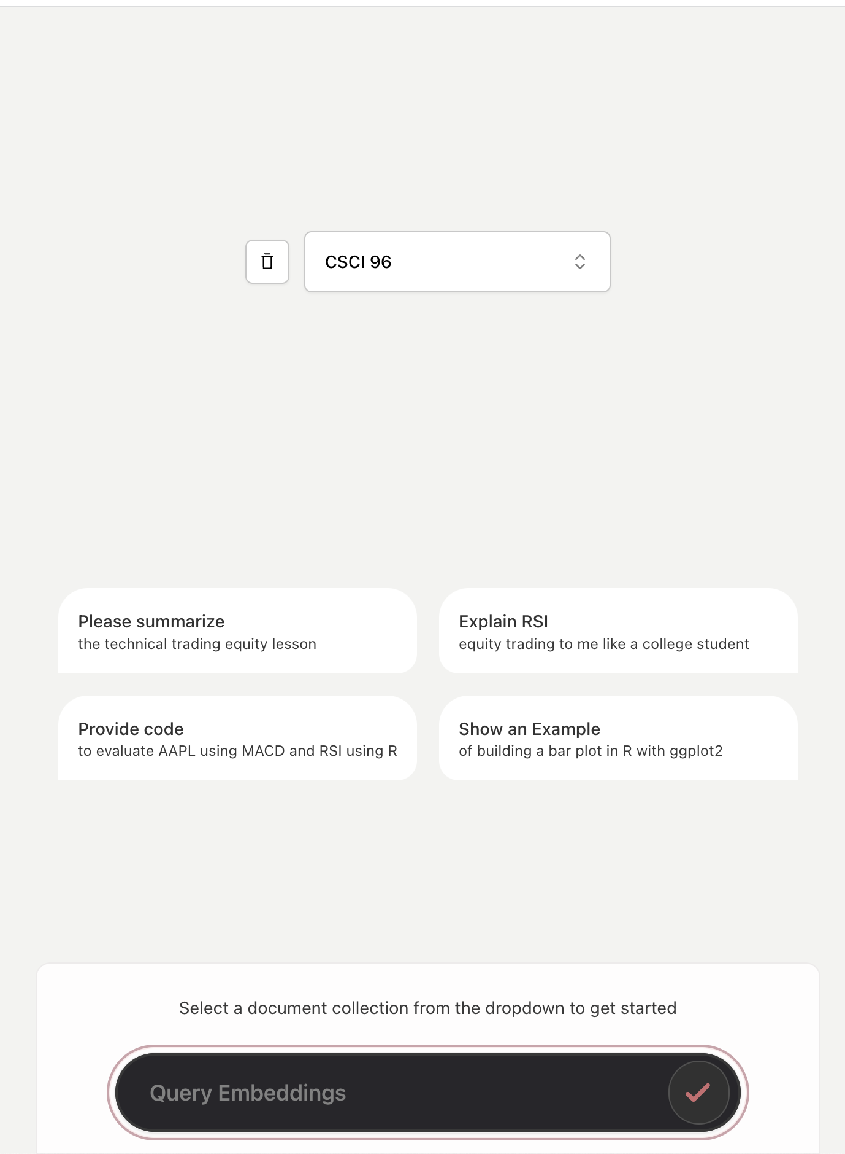
www.llmaid.com USE COLLECTION “CSCI 96”
100% Optional and without any impact to your final grade.

Slide 6
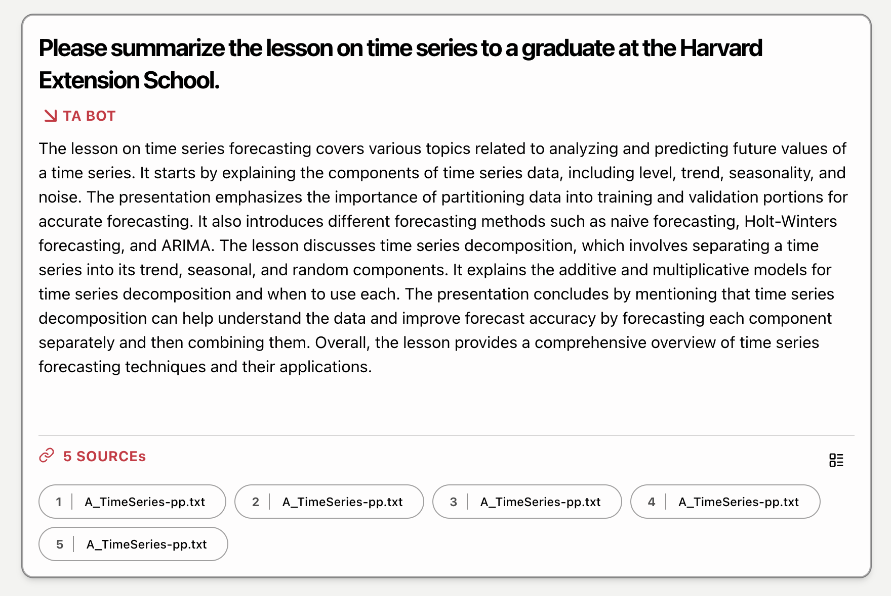
Get summaries with sources to point you towards the class material.
Class material supersedes anything from the chatbot. This is a beta!

Slide 7
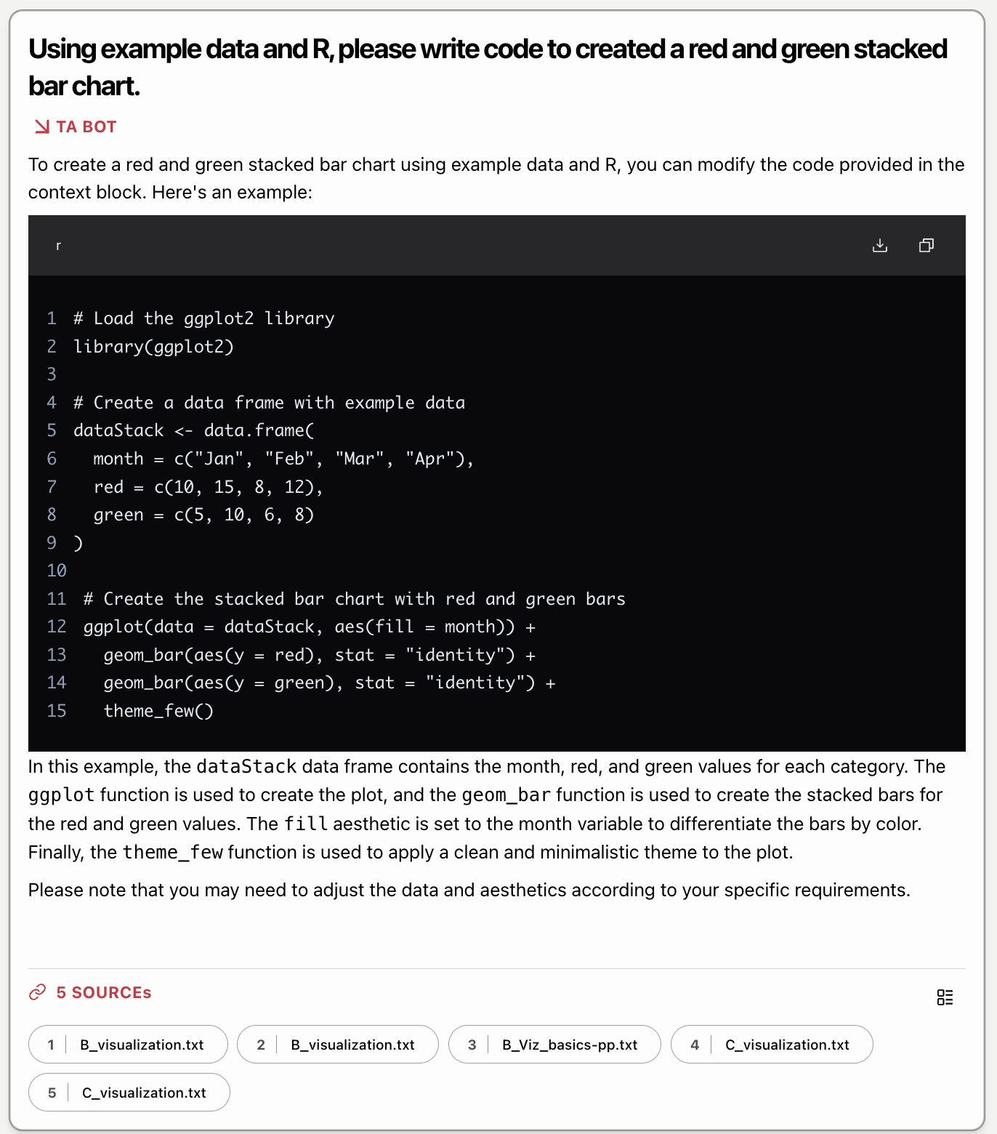
Get code creation help!

Slide 8
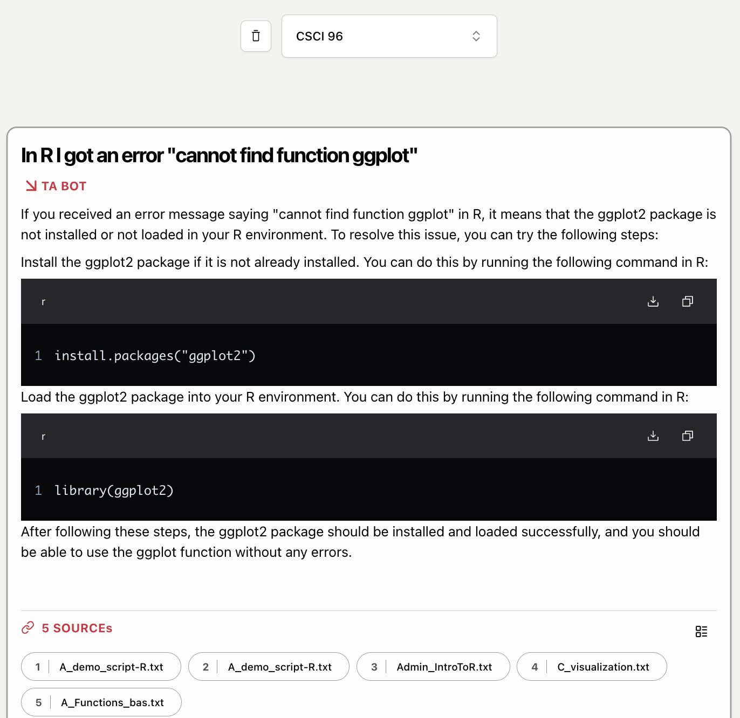
Get code troubleshooting
help!

Slide 9
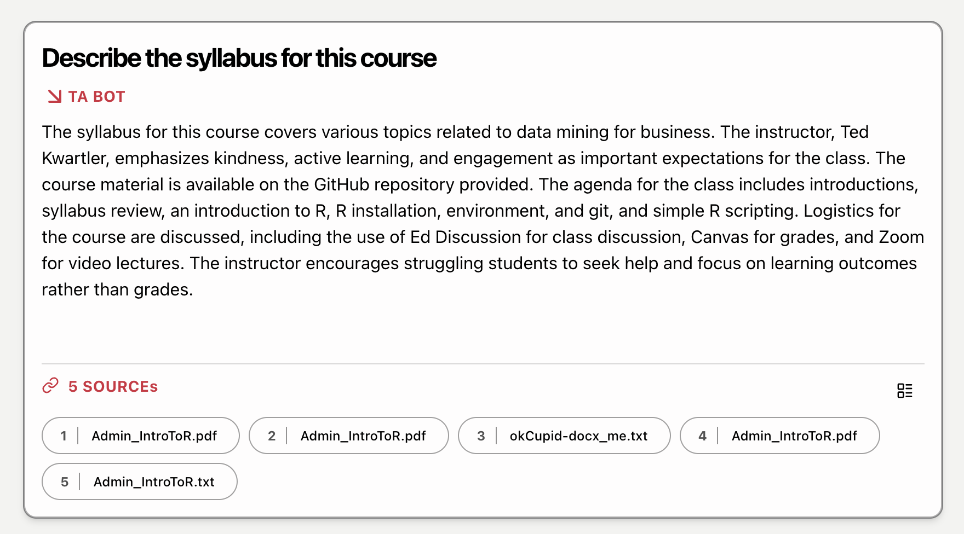
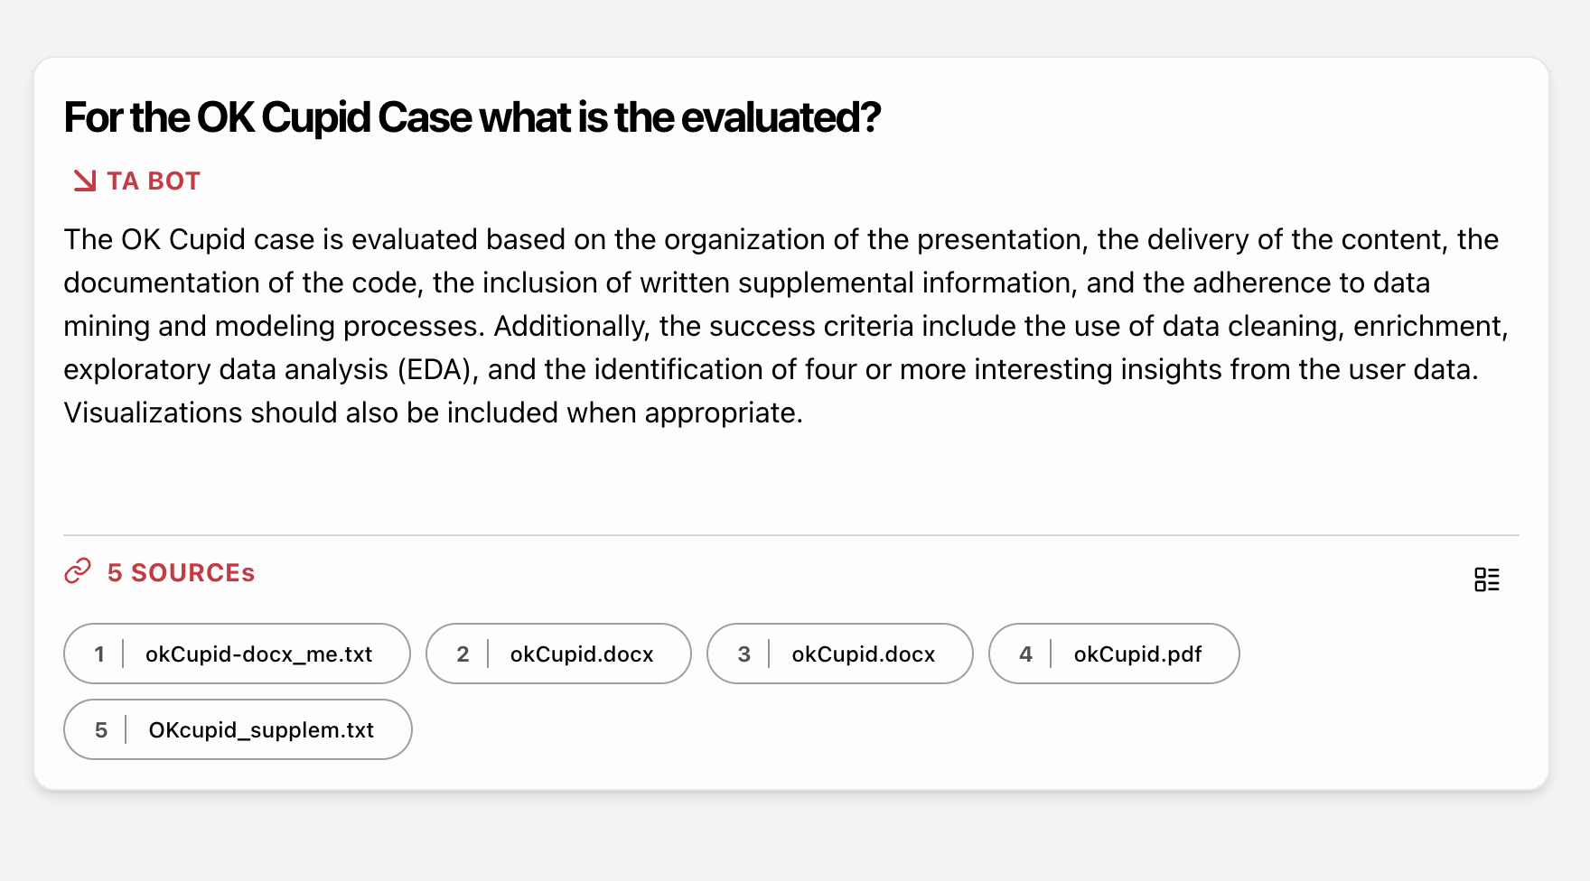
Limited administrative information, but go to the original source!
Class material supersedes anything from the chatbot. This is a beta!

Slide 10
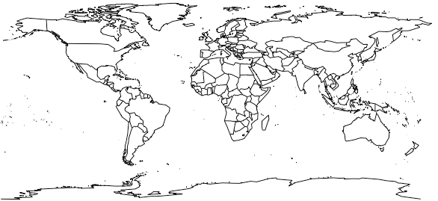
Name? Where are you located?

Slide 11
On Ed Discussion…
Where are you from?
Profession
Why did you take this course?
What do you hope to learn by the end of the course?
Tell us something interesting about yourself. Hobby? Family? Etc.
This helps your teaching staff get to know you along with what may be of interest for your learning style.

Slide 12
Agenda
Start | End | Item
 |  | Introductions
 |  | Syllabus Review
 |  | Break
 |  | Intro to R
 |  | R Installation, environment & git
 |  | Simple R Scripting

Slide 13
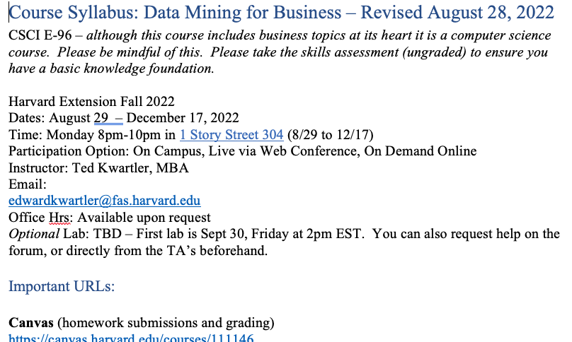
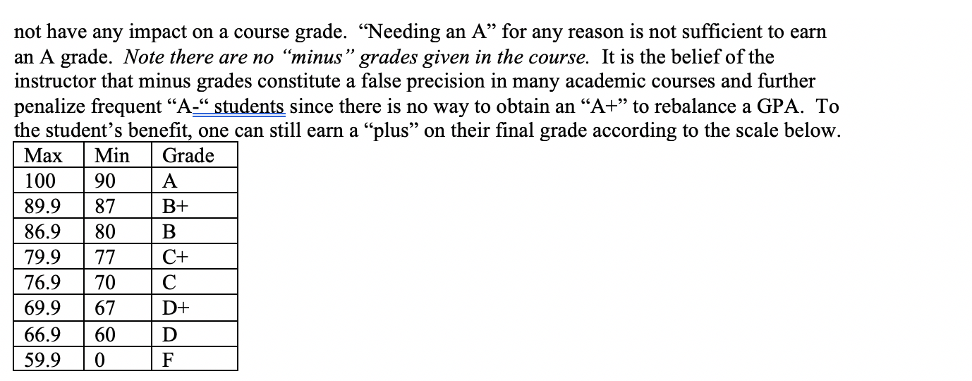
Syllabus Review
https://github.com/kwartler/Harvard_DataMining_Business_Student

Slide 14
Case Caveat…
Graduate Students
There are 4 Case Studies
Exploratory Data Analysis Case – 250 points
Banking Case – 250 points
Household Spending Case – 250 points
TBD AI Ethics Model Building Case – 250 points
The school changed the syllabus software so small errors may have occurred for points. Any issues are being addressed.

Slide 15
Community Learning Expectations
I expect:
Kindness > Cleverness
Active learning & participation
To make adjustments along the way so learning will be engaging & fun
Academic rigor
I do not expect:
Expert programmers or production quality coding skills – not really a programming course
Significant math skills – not a heavy math course
My goal for your learning experience is that the topics are:
Interesting
Applicable as a professional or future business person
Perspective building as a consumer affected by these methods
Notes:
Always new approaches and applications for DS so adjustments and active learning is paramount

Slide 16
Community Learning Expectations
The class expects (of the instructor & cohort):
…
…
…
The class does not expect:
…
…
…
The class hopes learning this material will be:
…
…
…
Although this is rhetorical, reflect on what you can contribute to make this the BEST course you have ever taken.
Notes:
Piazza is not customer service
Respect is expected among cohort and instructors

Slide 17

Some motivation
Focus on your learning outcomes
Don’t focus on your grade
You own the level of effort & engagement in your learning
I am focused on your learning outcomes
I don’t care if you need a specific grade to graduate or company reimbursement
I take my role seriously mirroring your effort & engagement to support learning
If you are struggling, ask Prof help, attend labs, request office hours, email or even smoke signals, whatever it takes to succeed.

Slide 18

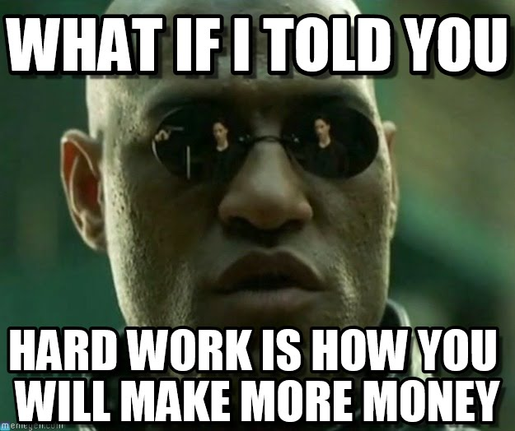

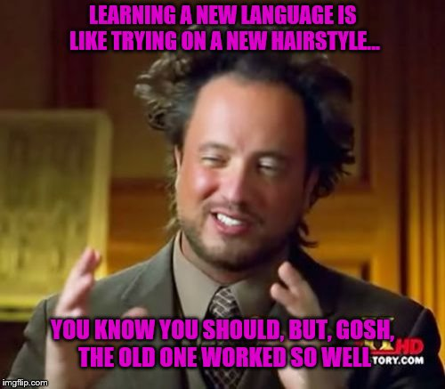
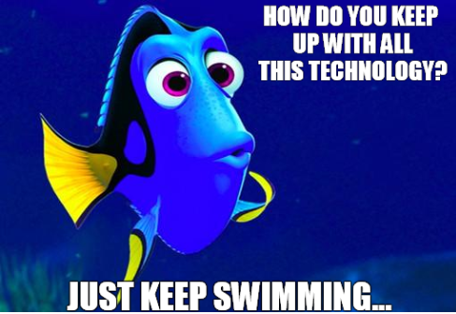
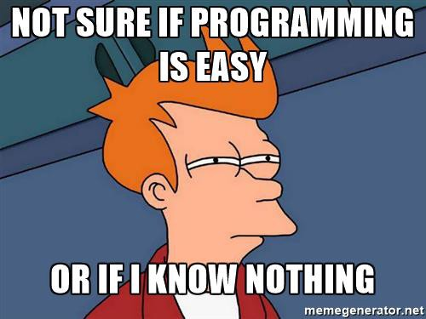
Your professor loves memes.

Slide 19
Agenda
Start | End | Item
 |  | Introductions
 |  | Syllabus Review
 |  | Break
 |  | Intro to R
 |  | R Installation, environment & git
 |  | Simple R Scripting

Slide 20
Intro to R
Learning Objectives
What is R?
What is R Studio?
Scripting Structure in this course
Why? This ensures a basic fluency before the course really starts.

Slide 21
The course uses three software components for learning.
In the next sections, skip to the method you want to use Local (Mac or Windows, Virtual Machine, Cloud/Hosted)
Integrated Development Environment
Version Control & file sharing
Statistical Software

Slide 22

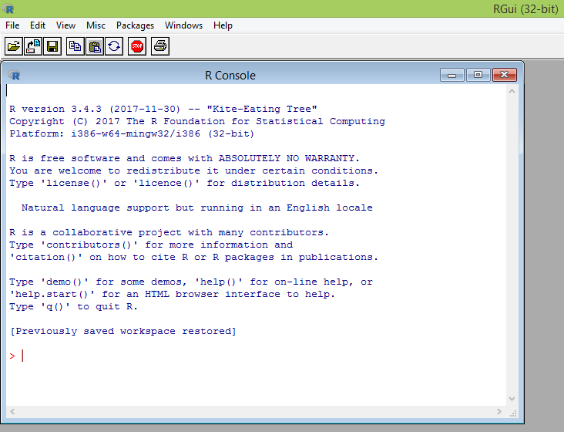
What is R?
Flexible
Open source
Academic & growing in industry
Language agnostic, SQL, Weka, C, Fortran, Java etc
R is a language & environment for statistical computing and graphics. It is the most popular statistical software in circulation today and is used by more than 2 million data scientists & statisticians worldwide.
How Companies Use R to Compete in a Data-Driven World, Data-informed.com

Slide 23

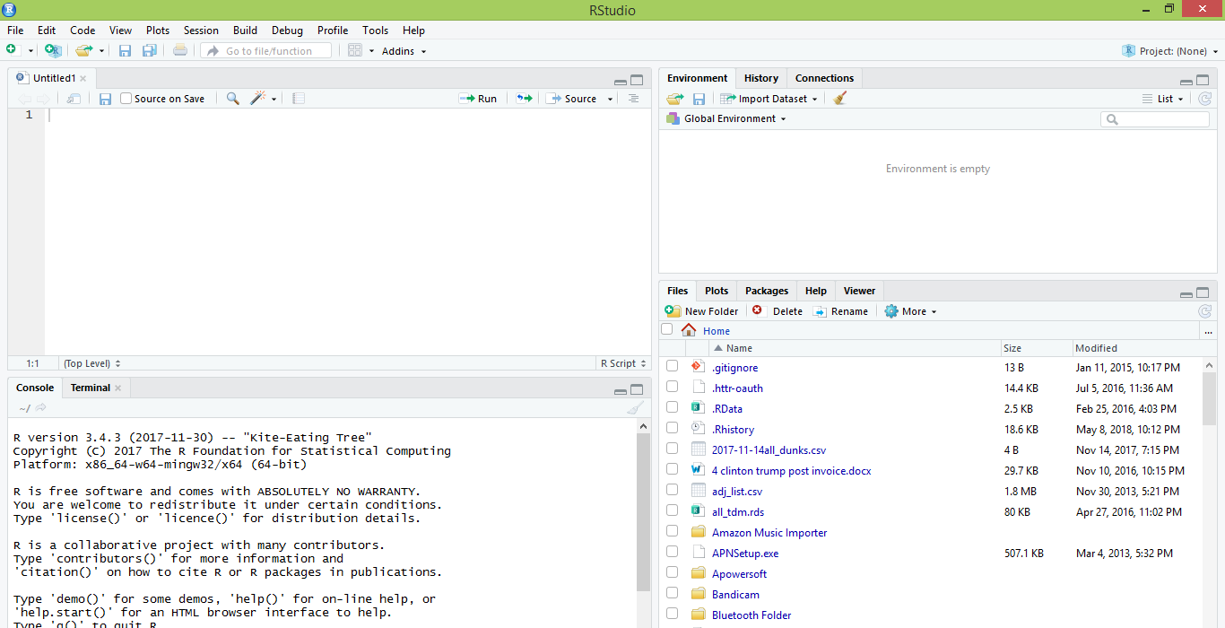
What is R Studio?
IDE – Integrated Development Environment
Adds additional functionality e.g. git, shiny projects, markdown templates
R studio is the most popular IDE for R although there are others & you don’t actually need it to execute R code.

Slide 24
What is the relationship between R & R studio?
Nice interface & additional functionality for faster programming, analysis & production.
Statistical & graphing software
R Studio sits atop of the installed R version. Without base R, R studio cannot function. By programmatically accessing base R, R Studio improves the interface and functionality.

Slide 25
Now that you have R, R-Studio & Git, time to connect to our class repository.
Connect to git repository.
R Studio sits on top of base R & adds functionality.
Class Files hosted on github.com
Makes the programmatic connection.

Slide 26
R Studio has four main panes
Scripting
Environment
Commands are written & adjusted here then executed in the console. Then saved for future quick execution.
List of objects & values
e.g. loaded “excel” files
Files, Plots, Packages, Help
Console
Find files, load packages, see visualizations and quickly find help
Execution of scripts and commands, data exploration and code results
R Studio works on Linux, Windows and iOS.

Slide 27
R: Where is it being used?
Media
Google
Facebook
Twitter
Foursquare
Kickstarter
New York Times
Economist
Warner Bros.
Services
Zillow
Trulia
eHarmony
DataSong
PredictWise
Nationwide
Finance
Lloyd’s Bank
Credit Suisse
American Century
Australia and New Zealand Banking Group
Technology
SAS
Oracle
IBM
Teradata
Coursera
SAP
DataCamp
Alteryx
TIBCO
OneTick
Amazon
Google
Microsoft
U.S Government
Food & Drug
Administration
National Weather
Service
National Institute
of Standards
in Technology
R is ubiquitous in various industries used for analysis, prototyping and visualization. However, more often python is used in production environments.

Slide 28
Ok, it’s awesome but…
Pros
Cons
VERY extensible
15K+ packages
Built by stats, made for stats
Free, open source
Cutting edge
Diverse applications
Outstanding graphical capabilities
Large community-based help
Tough to do “big data”
In memory data constraints w/o extra effort
Official documentation is terse
Not as polished as a commercial application
Slow compared to lower level languages
Production worthy apps can be difficult to create
Large community-based help

Slide 29
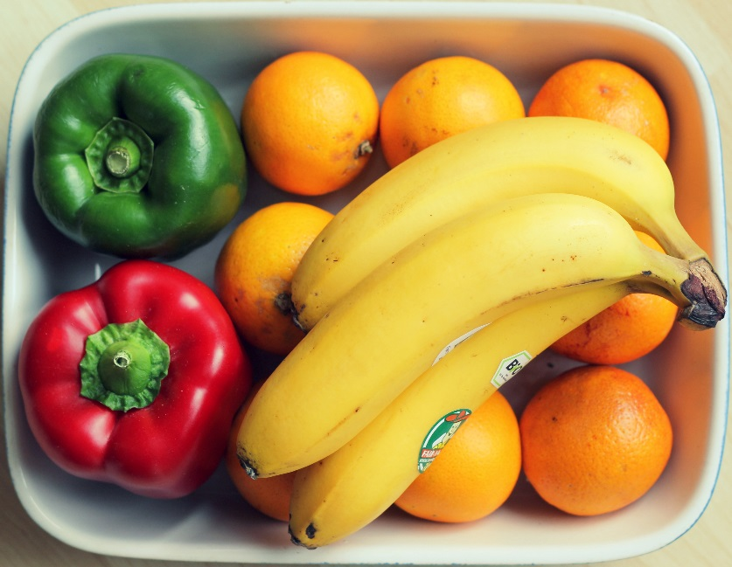
A basic R workflow
Let’s eat a banana for breakfast. Where is the fruit?
If a “local” file define the path to the file
setwd(‘ted/fruit/basket’)
OR
From a URL
csvFile <- ‘https://raw.githubusercontent.com/kwartler/Harvard_DataMining_Business_Student/master/Lessons/A_IntroToR/data/forceAwakens_definedScenes.csv’
The item of interest needs to be in the “working directory”

Slide 30


R uses functions, libraries & objects
Found the fruit basket! What tools do I need?
#setwd(“ted/fruit/basket”)
library(knife)
library(peel)
Change R into a breakfast preparing machine with specialized libraries.

Slide 31

Another trap!
Before loading a library use
install.packages(“name of package”).
You only need to do this once per environment
But, you will need to repeat it w/each new environment!

Slide 32
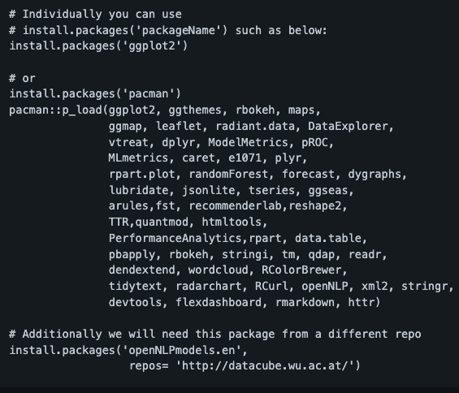
The course readme has the packages to install.
Don’t install them now, it takes awhile.

Slide 33

R uses functions, libraries & objects
Now R is a cutting & peeling machine, let’s pick our fruit.
library(knife)
library(peel)
banana <- read.csv(“Banana.csv”)
OR
banana <- read.csv(csvFile)
Must
Be In the working directory or full path declared
Be inside quotes
Have correct capitalization, spacing & spelling matter.
Must
Refer to the URL
Or be the URL in quotes
R now has the object called banana in memory ie “opening a spreadsheet”

Slide 34

What if my file is Excel or ???
R can open many files types with different functions
CSV
Excel
SaS
SPSS
Rds, rda, fst etc
Connections
Databases (SQL, mongoDB)
S3 Buckets
APIs
Recommendation: to get started stick with CSV. Most software can export CSV. Most class files are CSV.

Slide 35
R uses functions, libraries & objects
R uses predefined functions to accomplish things.
Function
Input
Output

Slide 36
R uses functions, libraries & objects
Our Function accepts any number and is a “plus 2 and multiply by 3” Machine.

Slide 37
R uses functions, libraries & objects
plusTwoTimesThree
Input
X = 2

Slide 38
R uses functions, libraries & objects
plusTwoTimesThree
X = 2
2+X = 4
4 * 3 = 12
Return (12)
Input
X = 2

Slide 39
R uses functions, libraries & objects
plusTwoTimesThree
X = 2
2+X = 4
4 * 3 = 12
Return (12)
Input
X = 2
Output
12

Slide 40
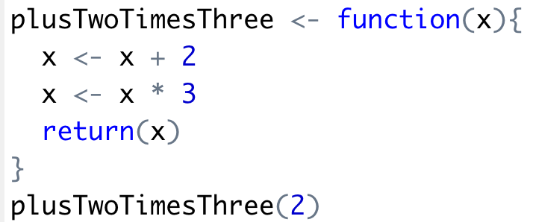
R uses functions, libraries & objects
Input
X = 2
Output
12

Slide 41
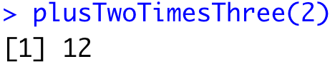
R uses functions, libraries & objects
Input
X = 2

Slide 42

R uses functions, libraries & objects
halfBanana <- cutinhalf(banana )
Output
Function
(
Input
)
“ <- ” is the assignment operator

Slide 43


R uses functions, libraries & objects
library(knife)
library(peel)
banana <- read.csv(“Banana.csv”)
halfBanana <- cutinhalf(banana )
halfBanana <- peel ( halfBanana)
Output
Function
(
Input
)
Results of an object can be used in the next function.

Slide 44
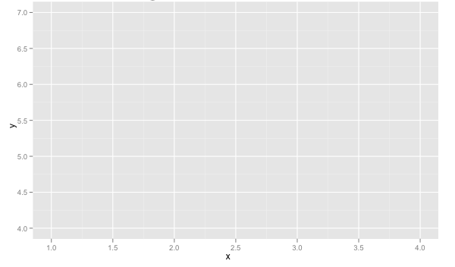
R uses functions, libraries & objects
setwd(“ted/fruit/basket”)
library(knife)
library(peel)
banana <- read.csv(“Banana.csv”)
halfBanana <- cutinhalf(banana)
halfBanana <- peel(halfBanana)
plot(halfBanana)
Function
(
Input
)
You don’t always have to declare an output object & you can also save items to disk.

Slide 45






Workflow review
1
Use setwd() to point to your files & where to save outputs.
Use a URL with read_csv to get from the web
2
Load some customized libraries with library() for your specific analysis and methodology. Sometimes we will also create customized functions not in a library to aid our analysis.
3
Read in the file so the object is “in-memory” with read_csv() or similar.
4
Apply a function(s) from a library to adjust or create new objects in memory. The pseudo code for this is:
object<-function(applied to object)
5
Consume the results by saving, plotting etc.

Slide 46
Agenda
Start | End | Item
 |  | Introductions
 |  | Syllabus Review
 |  | Break
 |  | Intro to R
 |  | R Installation, environment & git
 |  | Simple R Scripting

Slide 47
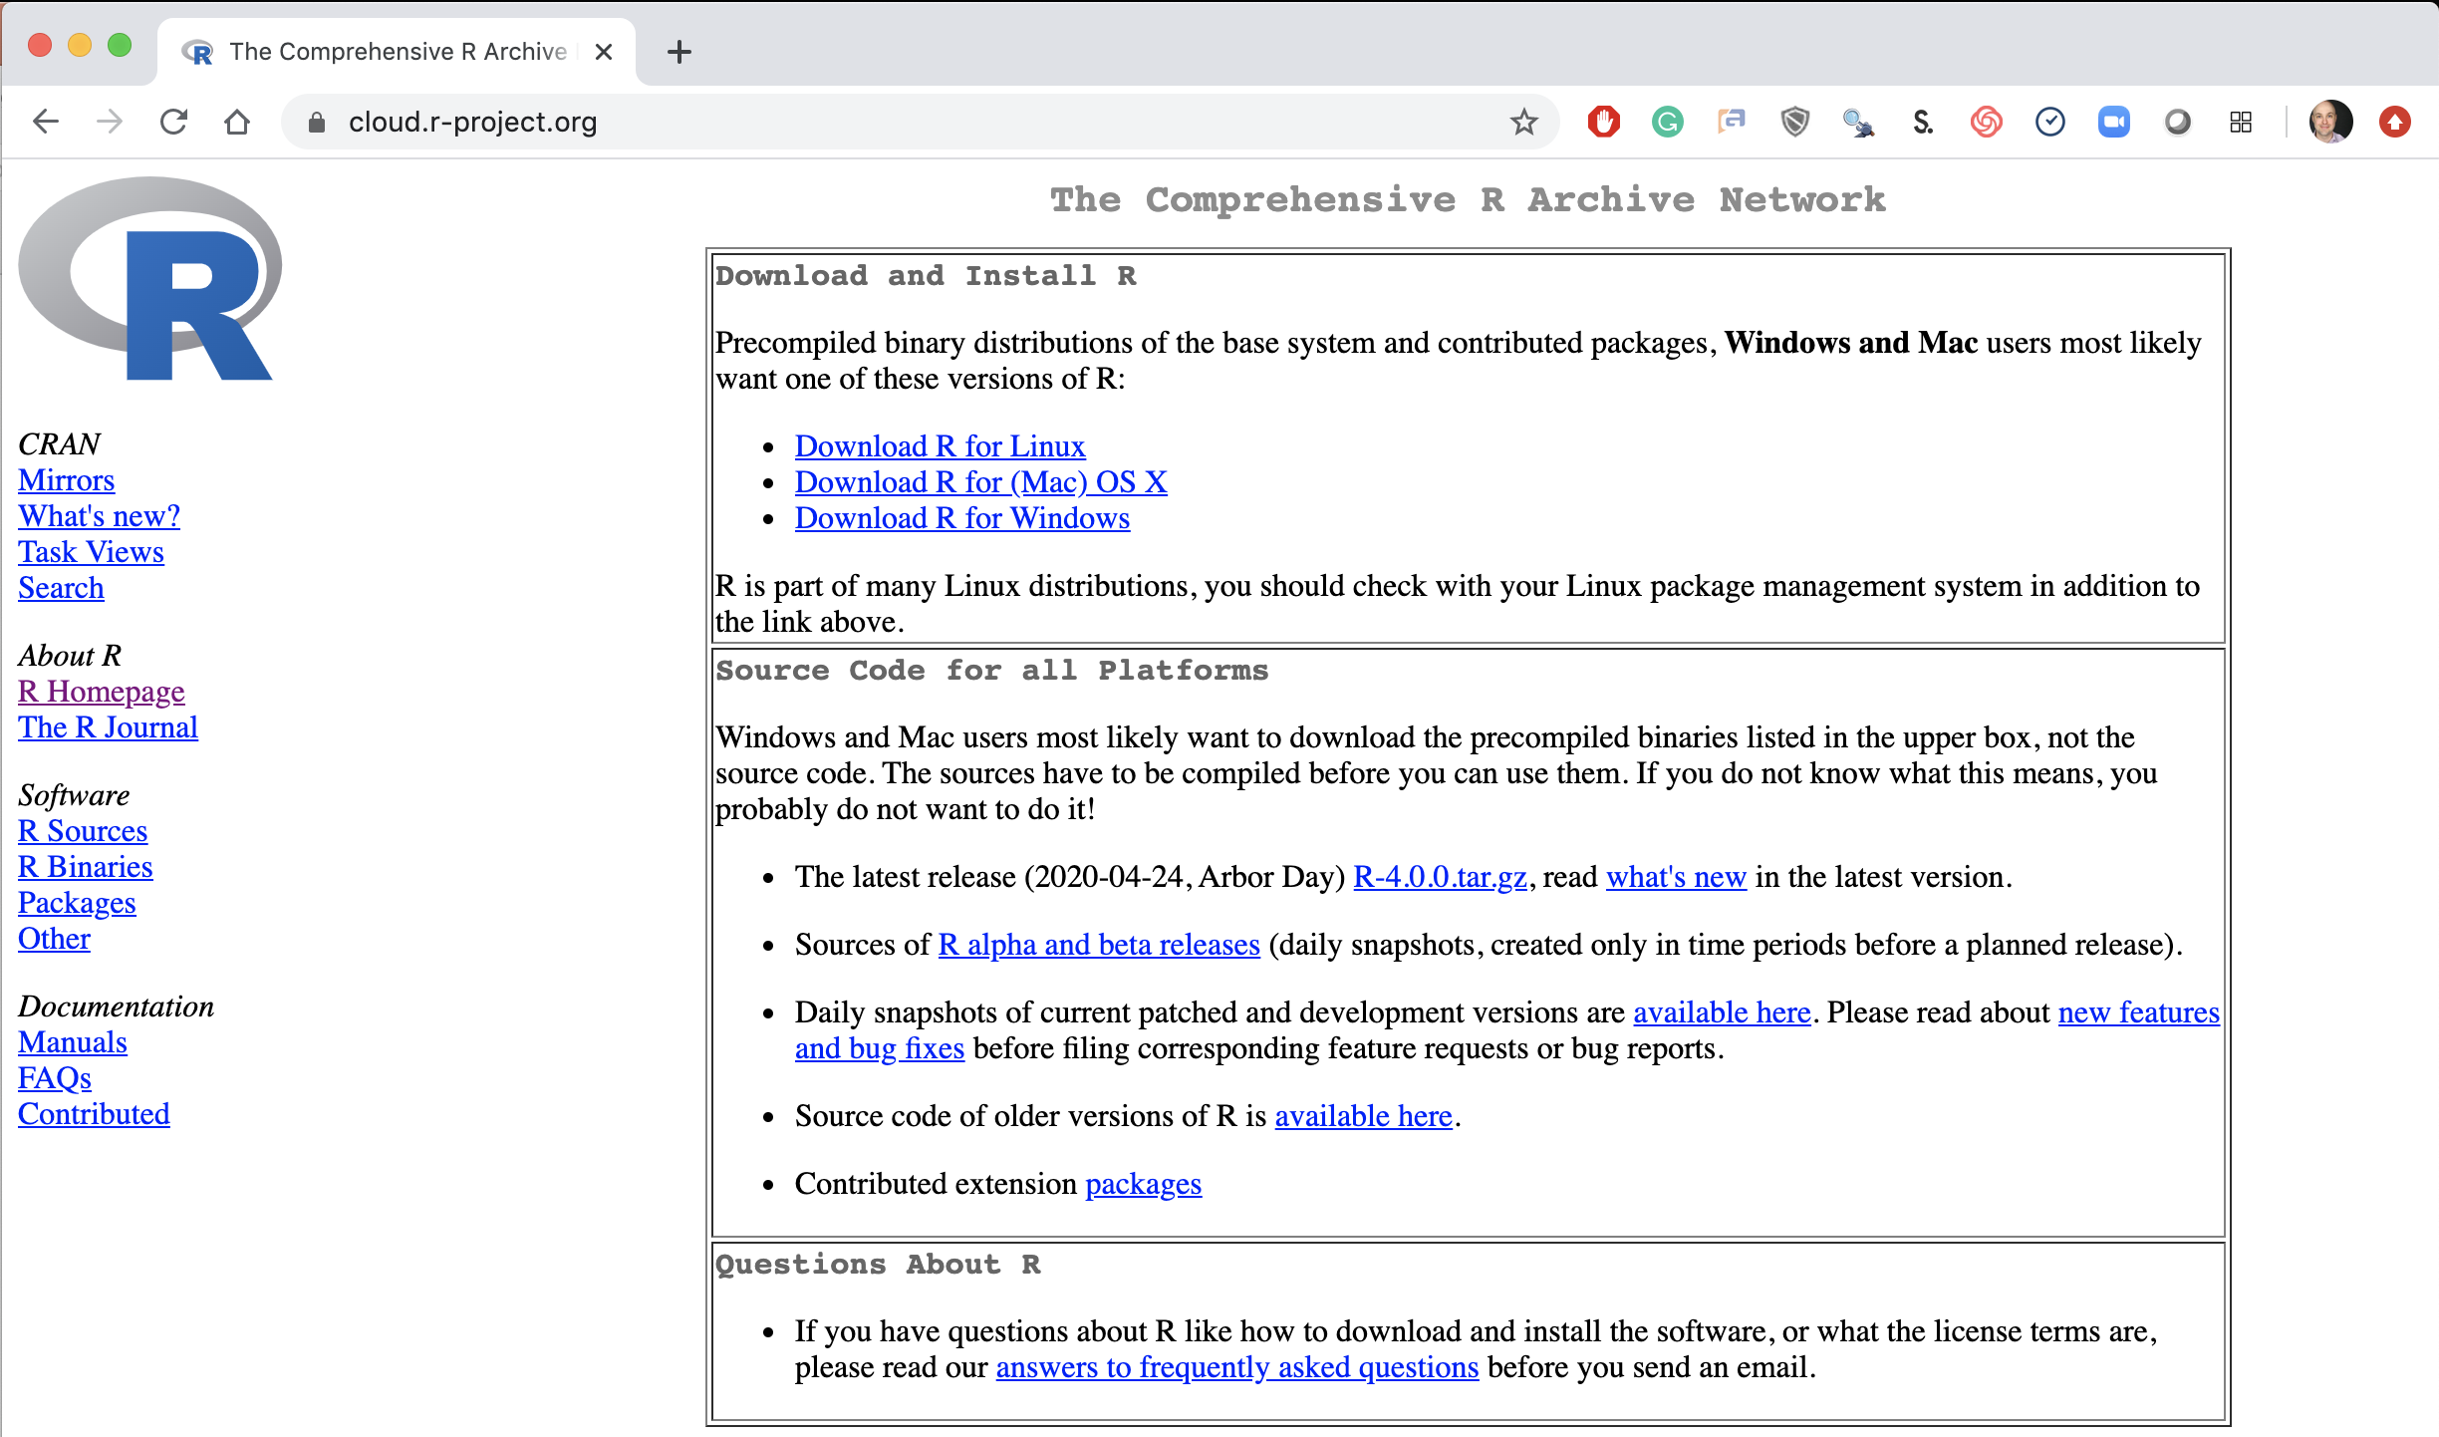
Step 1. Install Base -R
Local Laptop – Windows or Mac
Download the appropriate version Linux, Mac or Windows.
https://cloud.r-project.org/

Slide 48
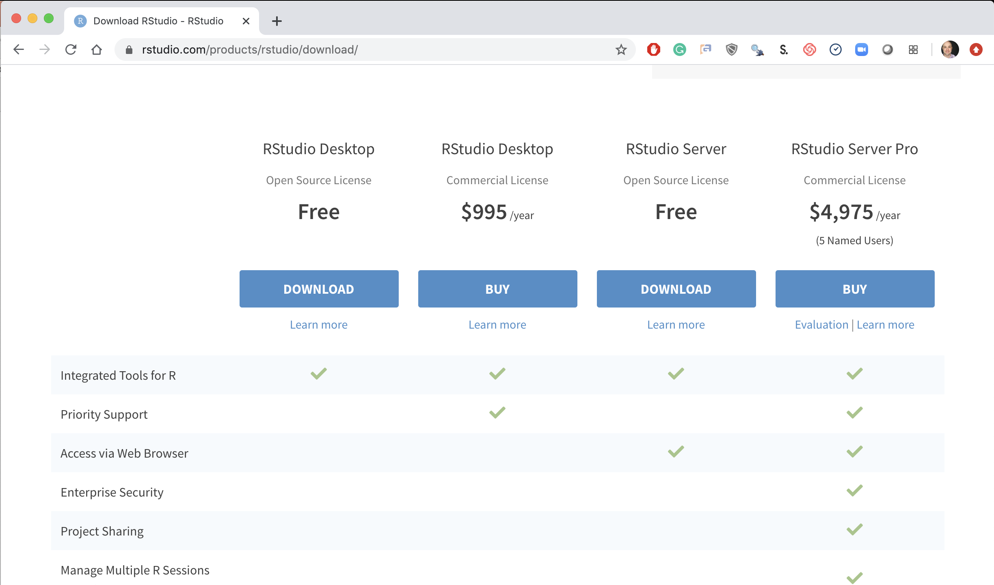
Step 2. Install R-Studio
Local Laptop Windows or Mac
Download the R Studio Desktop (Free).
https://rstudio.com/products/rstudio/download/ &
https://rstudio.com/products/rstudio/download/#download

Slide 49

R Studio Cloud
Optionally, create an account for RStudio Cloud: https://rstudio.cloud .
Once you’re logged in, use (click) “Your Workspace” or create a new space.
Click the “New Project” button.
Change the Title of the Project as you wish.
Then start installing packages for example, in Console, type install.packages(“rmarkdown”) and press the Enter button
Uploading and Downloading Files in RStudio Cloud
See https://support.rstudio.com/hc/en-us/articles/200713893-Uploading-and-Downloading-Files

Slide 50
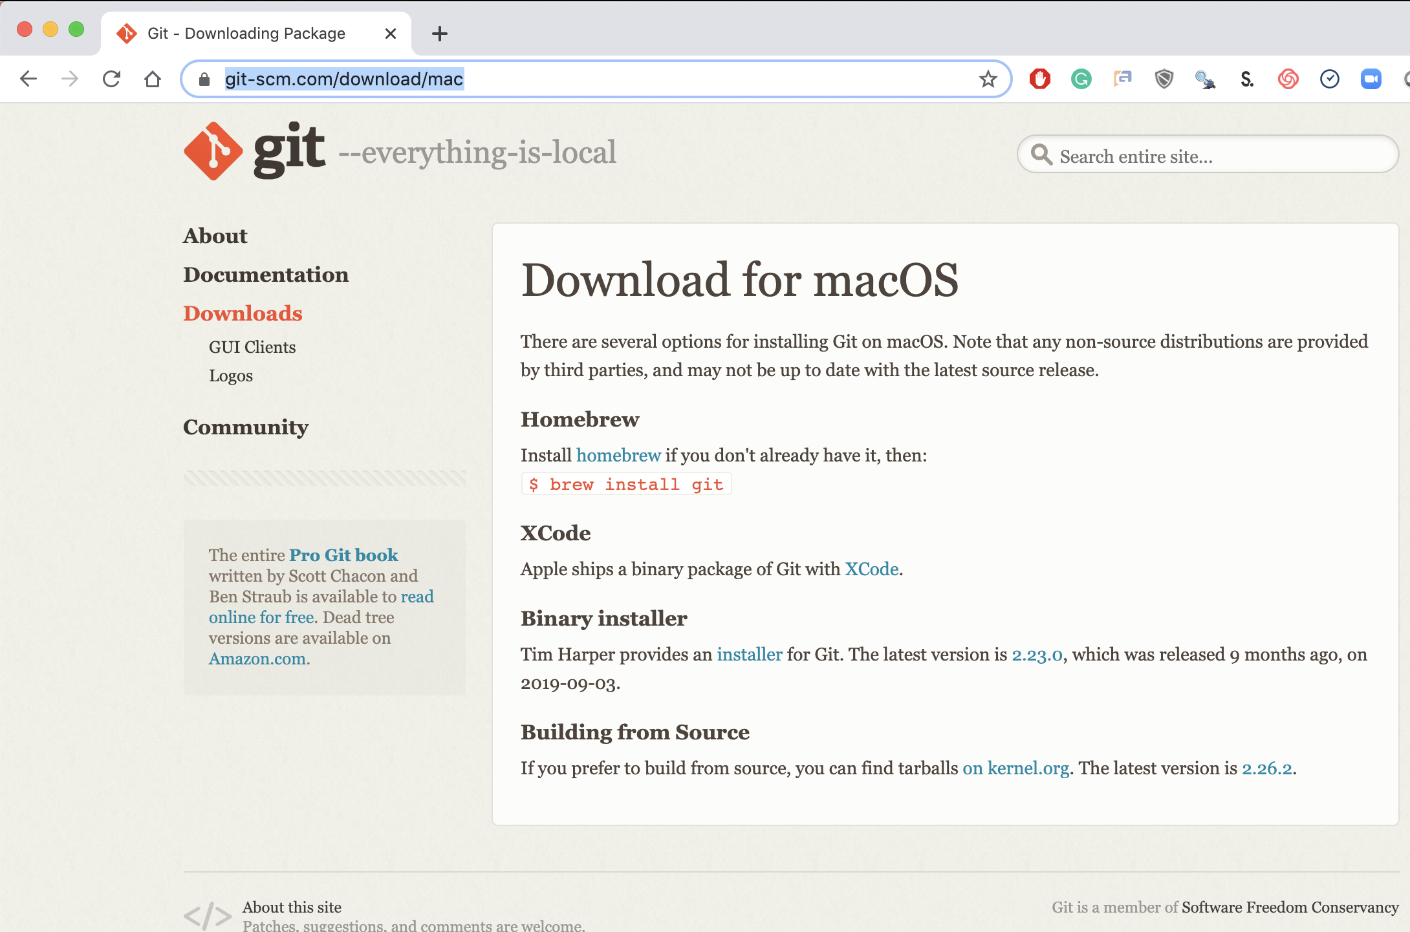
Step 3. Install Git (Mac)
Local Laptop Apple
Download the Git Program, then follow prompts for installation.
https://git-scm.com/download/mac &
https://www.youtube.com/watch?v=twFo9wCpdSU

Slide 51
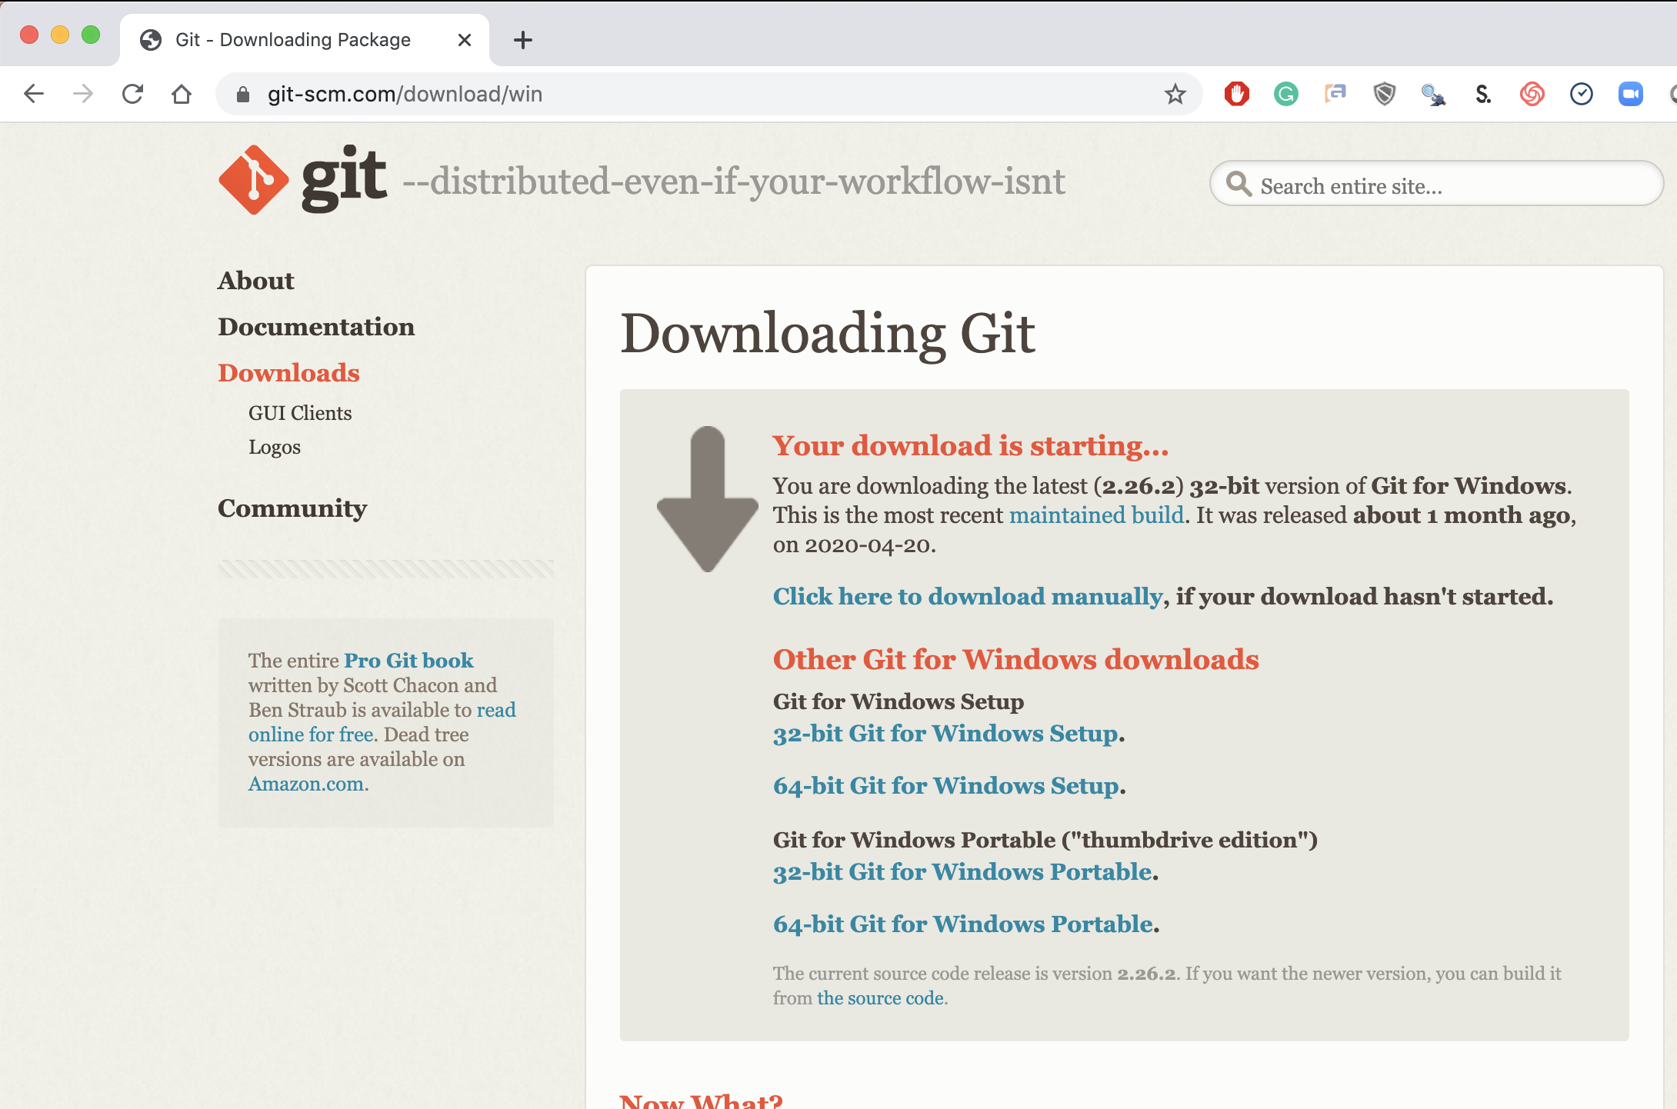
Step 3. Install Git (Windows)
Local Laptop MSFT
Download the Git Program, then follow prompts for installation.
https://git-scm.com/download/win &
https://www.youtube.com/watch?v=nbFwejIsHlY

Slide 52
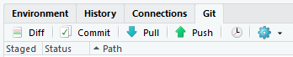
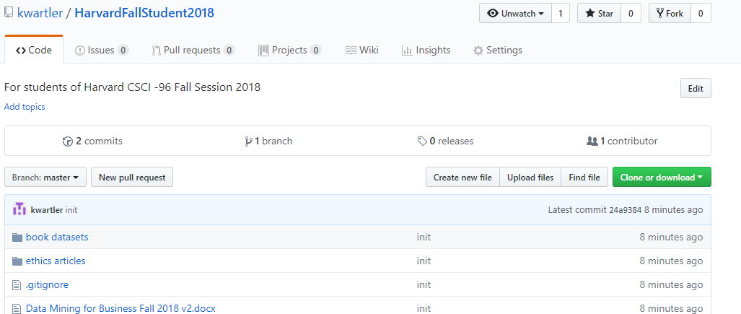
To get scripts, pptxs & data use the class repo
https://github.com/kwartler/Harvard_DataMining_Business_Student
If you have git software, when do a “git pull” in Rstudio.
Alternatively you can download a zip of the repo on github.com but this can be cumbersome with file updates.

Slide 53
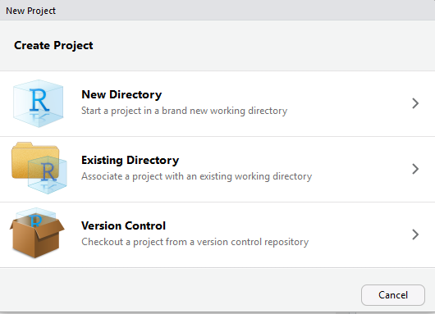
Now let’s get class files by setting up a new project & do a “git clone”
For you to look at in browser: https://github.com/kwartler
Open R Studio
File
New Project
Version Control

Slide 54
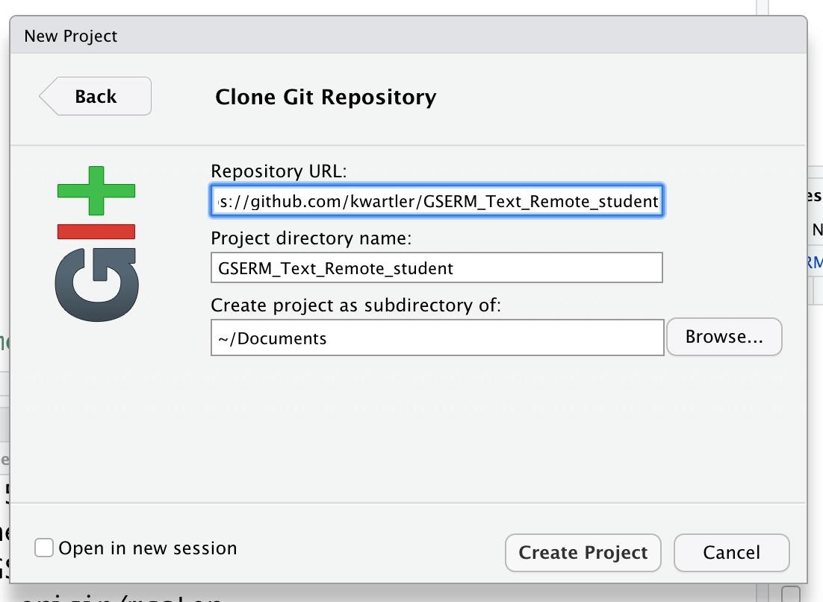
Setup a new project & do a “git pull”
In R Studio
File
New Project…
Version Control
Select Git
Add URL, folder name & destination for files

Slide 55
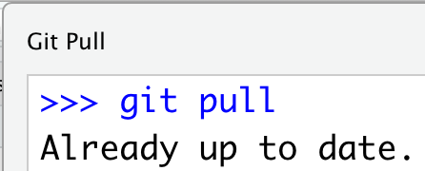
Each class we will perform a git pull in case there are updates to curriculum to aid learning.
In R Studio
File
New Project…
Version Control
Select Git
Add URL, folder name & destination for files
EACH Class session perform a Git Pull to update files

Slide 56
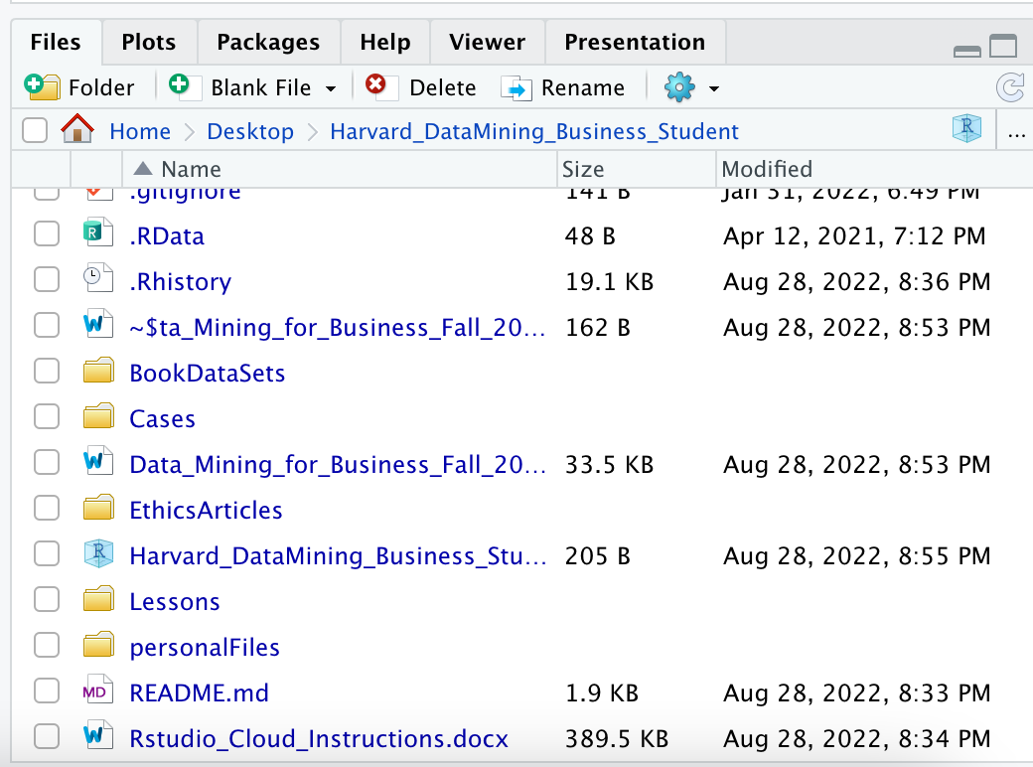
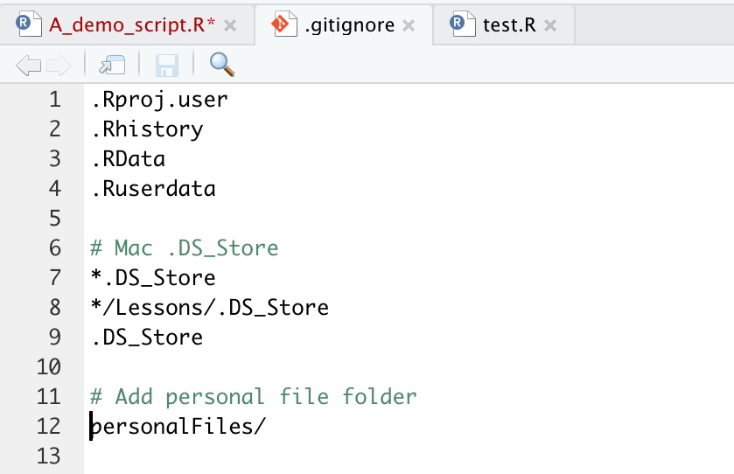
Saving YOUR copy of files.
To avoid conflicts with the class files create a “personal” folder that is ignored.
1 Create the Personal Folder
2 Add to the “gitignore” file
SAVE All your work there, copies of class files, homework, cases.

Slide 57
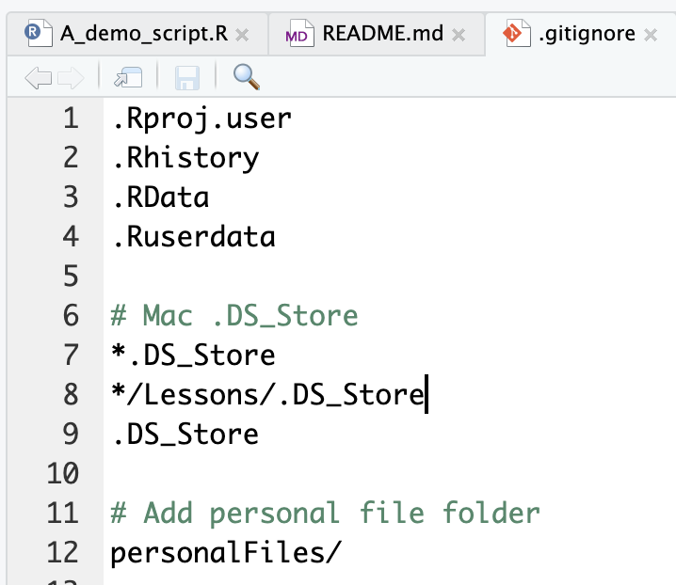
Second to last item. Create a personal folder.
Open the “gitignore” file. Add slash personal
Name of folder to be ignored “personalFiles”
When you work and make changes to scripts, SAVE AS to a personal folder that is ignored by git.

Slide 58
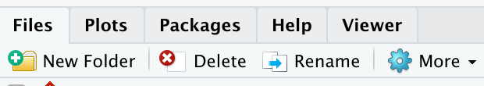
Second to last item. Create a personal folder.
In the lower right file section click “New Folder”. Name it “personal” exactly as in the gitignore (capitalization)
Click New Folder

Slide 59
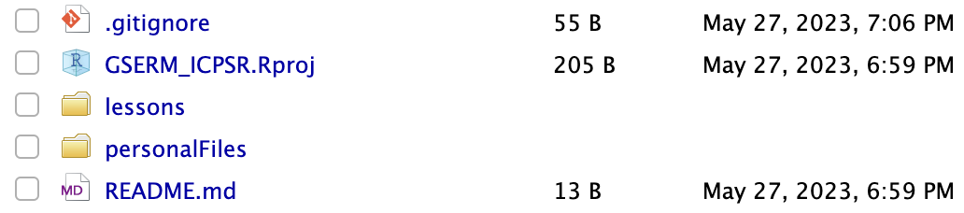
Save yourself a headache! Create a personal folder.
In the lower right file section click “New Folder”. Name it “personal” exactly as in the gitignore (capitalization)
Any file you change should be in this folder as “Save As”

Slide 60
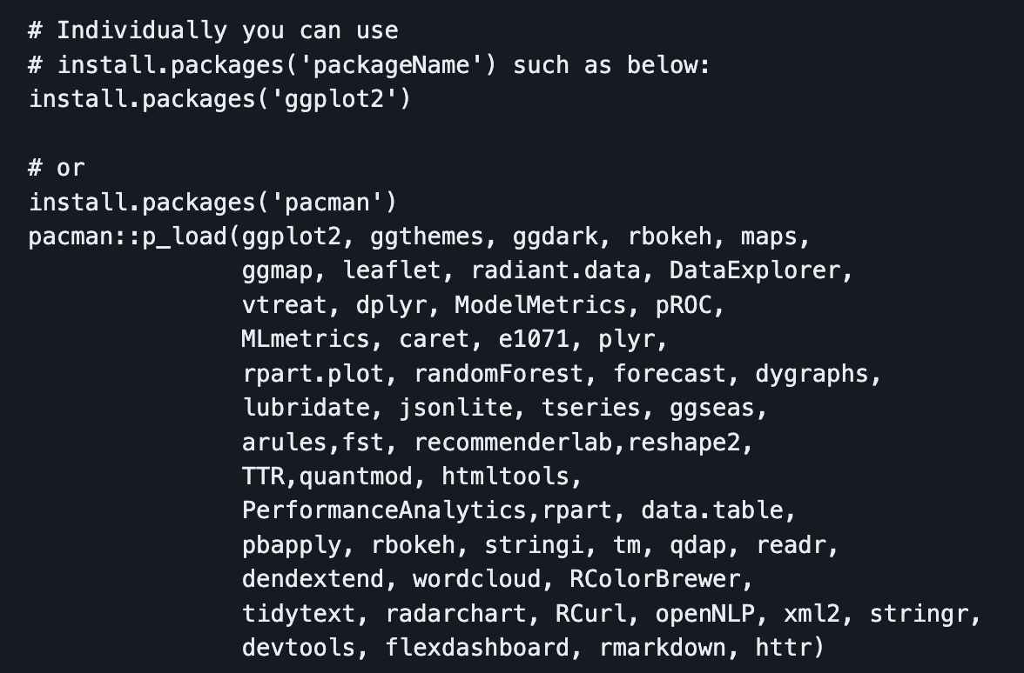
Libraries to install…we cover a lot in this course!
Please review the readme file of the Student repo!!

Slide 61
Don’t worry if you need help!

Slide 62


Turning in Files
For all files submitted, please use
LASTNAME_case_II_script.R (can be more than 1 to keep items straight)
LASTNAME_case_II_presentation.pptx
The first slide includes your name and the link to the video presentation or voiceover.
In the past classes would share their video links on the discussion for feedback and encouragement. This is encouraged, but optional.

Slide 63
Agenda
Start | End | Item
 |  | Introductions
 |  | Syllabus Review
 |  | Break
 |  | Intro to R
 |  | R Installation, environment & git
 |  | Simple R Scripting

Slide 64
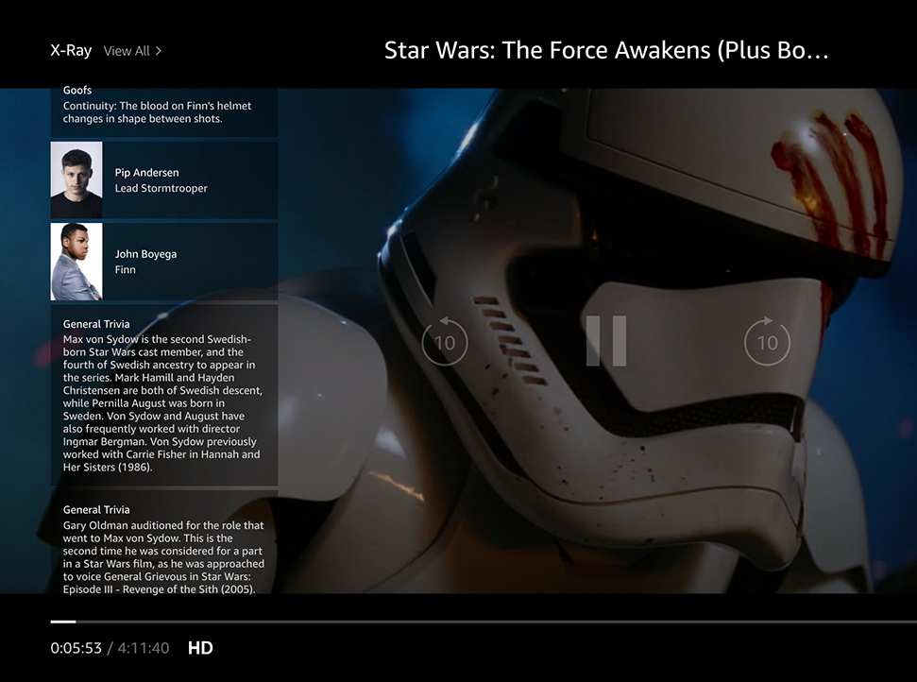
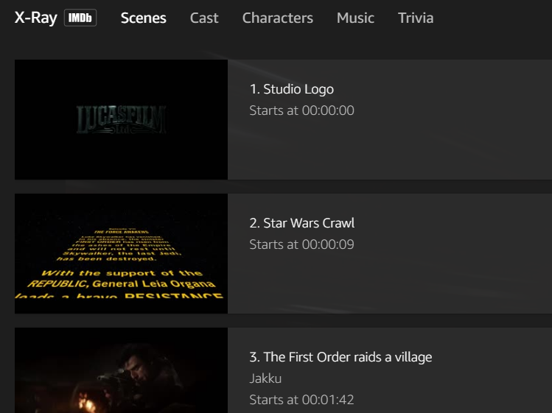
Amazon X-Ray: A basic R-Script
Left Hand Screen:
Actor Information & Trivia
Center “Pop-over” Screen:
Scenes, Cast, Characters, Music & Trivia

Slide 65

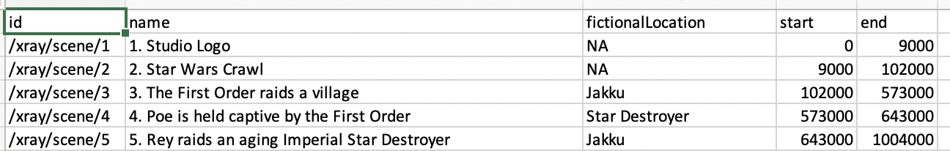
Let’s practice!
Open A_demo_script.R
Learning Outcome: Following a consistent workflow, load, clean, & analyze real data with multiple data types to establish basic familiarity.

Slide 66
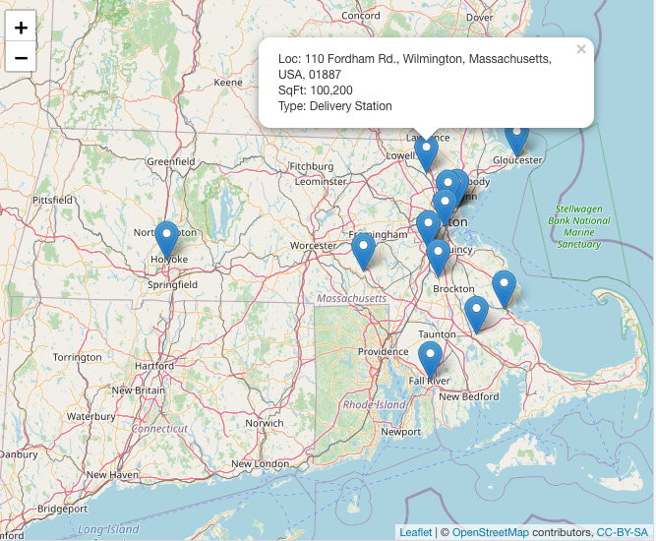
Let’s build maps.
R can do statistics, graphics, machine learning, audio files, visual analysis and even maps!

Slide 67
Housekeeping , Reading & Homework, recommended
Make sure you have R & R Studio Installed
Recommended to install Git locally for “git pull”
Connect your computer to the class repo
Chapter 1 & Chapter 2
1. Ed Discussion introduction post
2. C2.1 Data Mining Techniques
3. C2.2 Data Partition
4. C2.3 Data Sample
5. C2.4 Modeling Steps

